Slide 1

Hotel Management System
Welcome to the Hotel Management System, a simplified C++ program designed to streamline common hotel operations.

Slide 2
Booking a Room
The bookRoom function allows guests to book a regular room or a premium suite. It checks for room availability and updates the room booking status.
The system uses arrays to track the status of each room (regular rooms and premium suites). Regular rooms are numbered 1-5, and premium suites are numbered 6-7.

Slide 3
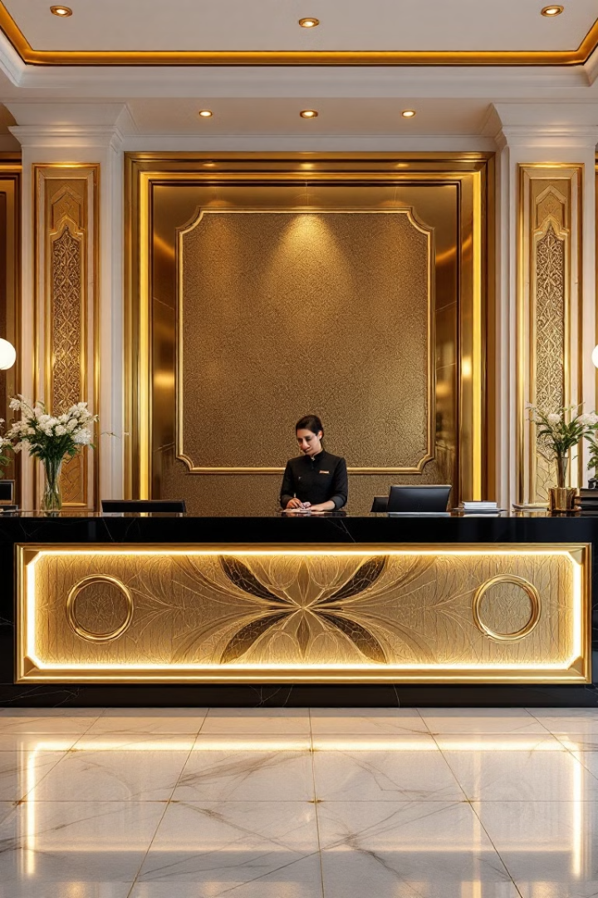
Checking Room Availability
Room Status
Array Iteration
The checkRooms function displays a list of available rooms.
The function iterates through the room arrays, checking for occupied rooms and printing the numbers of available rooms.

Slide 4



Room Service
Food
Cleaning
Guests can request room service, including food, cleaning, or other services.
The system validates the room number and service type before providing confirmation of the service request.

Slide 5

Generating a Bill
1
The generateBill function calculates the bill based on the room type and updates the payment status.
2
The user is prompted to select a payment method: cash or card. The system records the payment and marks the bill as paid.
3
The function validates the room number and payment method to ensure a valid transaction.

Slide 6



The Main Function
The main function is the heart of the program. It presents a menu with options for guests to interact with the system.
The menu allows guests to book rooms, check availability, request room service, generate a bill, or exit the program.

Slide 7





Code Structure and Function Calls
1
main
2
bookRoom
3
checkRooms
4
roomService
5
generateBill

Slide 8

Key Takeaways
This C++ code provides a fundamental framework for a simple hotel management system. By implementing a user-friendly interface, the system can enhance guest experience and streamline operations.

